Slide 1
COVID VACCINES ANALYSIS
Introduction:
The COVID-19 vaccines is a comprehensive examination of the various vaccines developed to combat the pandemic. This analysis typically covers their development, efficacy, safety, distribution, and impact on public health. It aims to provide insights into the effectiveness and challenges associated with different vaccine candidates, as well as their role in controlling the spread of the virus. This analysis may include data on vaccine types (mRNA, viral vector, inactivated, protein subunit, etc.), regulatory approvals, global distribution efforts, and ongoing research into booster shots and vaccine variants. It’s a crucial topic to understand the evolving landscape of COVID-19 vaccination.
Objectives:
Safety Evaluation: Analyze the safety profiles of vaccines, including adverse events and side effects, and compare them to the benefits of vaccination.
Vaccine Types: Compare and contrast the various vaccine platforms (mRNA, viral vector, inactivated, protein subunit, etc.) to understand their strengths and weaknesses.
Distribution and Equity: Assess the global distribution efforts, vaccine access, and equity in vaccine allocation, addressing issues of vaccine hesitancy and unequal access.
Variants and Boosters: Examine how vaccines perform against emerging SARS-CoV-2 variants and the role of booster shots in maintaining immunity.

Slide 2
Regulatory Approvals: Review the regulatory processes and approvals for vaccines in different regions and their implications.
Public Health Impact: Analyze the contribution of vaccines to reducing transmission, hospitalizations, and the overall impact on the COVID-19 pandemic.
Vaccination Strategies: Study the effectiveness of vaccination strategies, such as mass vaccination campaigns, age-based prioritization, and reaching vulnerable populations.
Global Collaboration: Explore international cooperation and initiatives to ensure vaccine availability and distribution.
Ongoing Research: Discuss ongoing research and development in the field, including vaccine candidates in clinical trials and potential advancements in vaccine technology
2. Data Sources:
Clinical Trial Data: Data from vaccine developers’ clinical trials, which provide information on vaccine efficacy, safety, and side effects.
Regulatory Agencies: Information from health authorities like the FDA (U.S.), EMA (EU), WHO, and other national regulatory bodies, which provide data on vaccine approvals and safety monitoring.
Vaccine Manufacturer Reports: Reports and publications from vaccine manufacturers that share data on their products.

Slide 3
Government Reports: Official reports and publications from governments and health agencies on vaccine distribution and strategies.
Survey Data: Data from surveys and studies that measure vaccine hesitancy, public perception, and barriers to vaccination.
Pharmaceutical Industry Data: Information from pharmaceutical industry reports, investor disclosures, and financial statements related to vaccine development and distribution.
Academic Research: Academic studies and research papers on various aspects of COVID-19 vaccines, including their mechanisms, technologies, and impacts.
Government Open Data: Many governments provide open data portals with COVID-19 and vaccine-related datasets for public use.
Social Media and Sentiment Analysis: Data from social media platforms and sentiment analysis tools to gauge public sentiment and discussions related to vaccines.
Public Health Agencies: Data from organizations like the CDC (U.S.), WHO, and national health departments, which provide statistics on vaccination rates, adverse events, and public health impact.
Scientific Journals: Peer-reviewed research articles and studies published in scientific journals that offer insights into vaccine efficacy, safety, and advancements.

Slide 4
3. Data cleaning:
Missing Data Handling:Identify and handle missing data points in the dataset. Options include imputation, removal, or flagging missing values.
Outlier Detection and Treatment:Identify and address outliers that may affect the accuracy of your analysis. You can choose to remove outliers or transform them.
Data Type Conversion:Ensure that data types are appropriate for analysis. Convert data to the correct types (e.g., dates to datetime objects, strings to numeric data).
Duplicate Data Removal:Check for and remove duplicate records from the dataset to avoid double counting.
Standardization:Standardize data units and formats to ensure consistency. For example, standardize country names, date formats, and measurement units.
Data Validation:Validate data for accuracy and consistency. Check for data that falls outside expected ranges or violates logical constraints.
Handling Categorical Data:Convert categorical variables into a numerical format, such as one-hot encoding or label encoding.

Slide 5
Data Scaling and Normalization:Scale and normalize numeric data to ensure that different variables are on a similar scale.
Aggregation: Aggregate data when necessary to create summary statistics or time-series data for analysis.
Handling Data Imbalances:Address imbalances in the data, especially in cases where certain outcomes or categories are underrepresented.
Handling Time Series Data:Ensure that time series data is properly structured, and time-related features are treated appropriately.
Dealing with Data Integrity:Verify data integrity to prevent data corruption or security breaches during the cleaning process.
Data Masking or Anonymization:When handling sensitive data, implement data masking or anonymization techniques to protect privacy and comply with regulations.
Data Version Control:Maintain clear documentation and version control of your cleaned datasets to track changes and ensure reproducibility.
Data Splitting:If needed, split the data into training, validation, and test sets for machine learning model.

Slide 6
4. Data structuring
Data Integration: Merge data from various sources into a unified dataset. Ensure that the datasets have a common key or identifier for proper integration.
Time Series Data: If your analysis involves time-based trends, structure the data with a clear time variable. Typically, this includes daily, weekly, or monthly data points, tracking vaccine distribution and other key metrics over time.
Geographical Data: If your analysis involves regional or global aspects, structure data by geographical location (countries, states, regions, etc.). Consider using standardized geographical codes or names for consistency.
Hierarchical Data: Organize data hierarchically, where applicable. For example, you may have data at the country level, which can be further broken down into states or provinces.
Categorical Variables: Encode categorical variables (e.g., vaccine types, regulatory approvals, adverse event categories) using numerical codes or one-hot encoding to make them suitable for analysis.
Normalization: Normalize data if needed, especially when comparing variables with different units or scales. Common techniques include min-max scaling or z-score standardization.

Slide 7
Data Aggregation: Aggregate data as required. Summarize data to different levels of granularity, such as daily, weekly, or monthly averages, to analyze trends effectively.
Data Joins: Perform joins or merges to combine data from multiple sources, aligning datasets based on shared keys.
Indexing: Establish clear indexing, such as primary keys, to facilitate data retrieval and efficient querying.
Documenting Metadata: Create a metadata dictionary that explains the meaning and format of each variable in your dataset for clarity and future reference.
Handling Missing Values: Decide how to handle missing data during structuring, whether through imputation, removal, or flagging.
Data Transformation: Apply necessary transformations, such as logarithmic scaling or percentage change calculations, to create variables that better suit your analysis.

Slide 8
5. Data documentation:
Data Dictionary:Create a data dictionary that provides detailed descriptions of each variable in your dataset. Include information on data type, units, and any transformations applied.
Data Source Information:Clearly state the sources of your data, including the names of organizations, websites, or databases where the data was obtained. Include URLs or references where applicable.
Data Collection Date:Record the date when the data was collected or accessed. This is crucial for understanding the temporal relevance of the data.
Data Cleaning Log:Document the steps taken during data cleaning, including how missing values were handled, outliers were treated, and any data transformations applied.
Variable Definitions:Provide clear and concise definitions for each variable, specifying its purpose and significance in your analysis.
Data Format and Structure:Describe the format and structure of your data, including the file type (e.g., CSV, Excel, JSON), the number of records and fields, and any hierarchical or time series structure.

Slide 9
6. coding
import matplotlib.pyplot as plt
# Sample COVID-19 case data by country or territory
data = {
'countriesAndTerritories': ['Austria', 'Germany', 'Italy', 'France', 'Spain'],
'cases': [5000, 8000, 6000, 7000, 7500]
}
# Create a pie chart
plt.figure(figsize=(8, 8))
plt.pie(data['cases'], labels=data['countriesAndTerritories'], autopct='%1.1f%%', startangle=140)
plt.title('COVID-19 Cases by Country/Territory')
# Show the pie chart
plt.show()

Slide 10
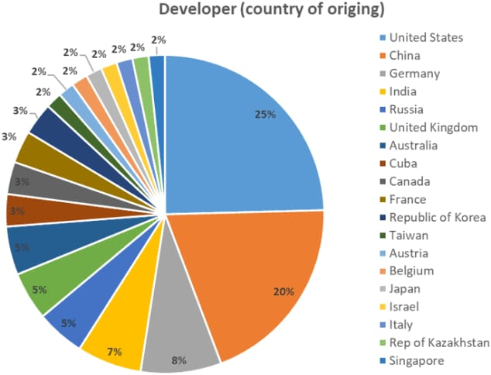

Slide 11
